Slide 1
DEFINITIONS

Slide 2
WHAT IS A DEFINITION?
a statement expressing the essential nature of something
a statement of the meaning of a word or word group or a sign or symbol <dictionary definitions>
a product of defining
the action or process of stating the meaning of a word or word group

Slide 3
Why Define Anything?
Increase reader understanding
Elaborate on technical terms
Improperly defined terms can have a negative impact

Slide 4
What Kind of Definition?
Consider your PURPOSE
Definitions will depend on AUDIENCE

Slide 5
TYPES OF DEFINITIONS
Decide how much detail your audience actually requires in order to grasp
your exact meaning.
Parenthetical
Sentence Variety
Extended

Slide 6
PARENTHETICAL
Least formal type of definition
In-line definition within a sentence enclosed in parenthesis ( …….)
Used as a clarification or brief explanation
Often, you can clarify the meaning of a word by using a more familiar synonym or a clarifying phrase in parentheses, as in these examples:
The trees on the site are mostly deciduous (shedding foliage at season's end).
Eventually, Artificial intelligence will be using cognitive science (scientific study of mind and its processes) to understand humans better,
Where to use a parenthetical definition?
Parenthetical definition is used for short clarification.

Slide 7
Sentence Definitions
More formal
Used to provide more information than parenthetical can offer.
Standard pattern of subject, class, distinguishing feature used.
Begin by stating the term. Then indicate the broader class to which this item belongs, followed by the features that distinguish it from other items in that general class.
Diabetes is a metabolic disease caused by a disorder of the pituitary gland or pancreas. This disease is characterized by excessive urination, persistent thirst and inability to metabolize sugar.
Artificial intelligence is the intelligence demonstrated by machines as opposed to natural intelligence displayed by humans. It leverage computers and machines to mimic the problem solving and decision making capabilities of the human mind.
Where to use sentence definitions?
When a term requires more elaboration than a parenthetical definition can offer, use a sentence definition.

Slide 8
Sentence definition
Sentence definitions are especially useful if you plan to use a term often and need to establish a working definition that you will not have to repeat it throughout the document:
Throughout this report, the term disadvantaged student will refer to all students who lack adequate funds to pay for on-campus housing, food services, and medical care, but who are able to pay for their coursework and books through scholarships and part-time work.

Slide 9
Extended Definition
Most formal
Long, paragraph definition
Allows for more complete understanding
Very flexible structure
Where to use extended definition?
Extended definition is used for complex or abstract ideas
Brief definitions are fine when your audience requires only a general understandingof a term. But a document which requires more details would call for an extended definition. It should display a level of technicality that is appropriate for the intended audience.
For Eg) A laser is an electronic device that emits a highly concentrated beam of light.

Slide 10
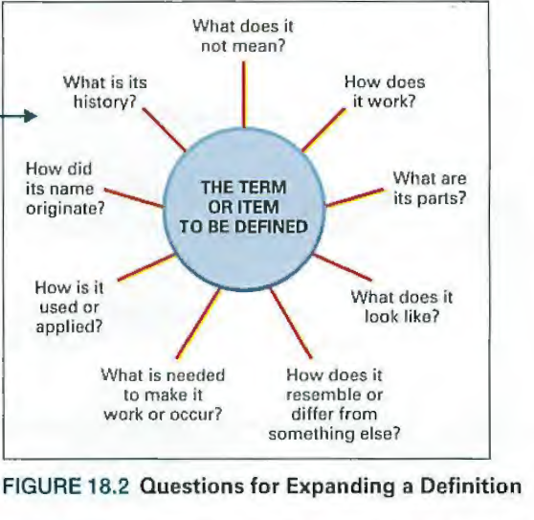

Slide 11
Placing definitions in a document
Each time readers encounter an unfamiliar term or concept, that item should be defined.
In a printed text, you can place brief definitions in parentheses.
Sentence definitions should be part of the running text or, if they are numerous, listed in a glossary.
Place an expanded definition either near the beginning of a long document or in an appendix depending on whether the definition is essential to understanding the whole document or serves merely as a reference.

